Slide 1
8051 micro controller
By
4438
4439
4442

Slide 2
8051 Microcontroller Hardware
It is a 8 bit microcontroller originally developed by Intel in 1980.
This is available in N-Channel Metal Oxide Silicon (NMOS) and Complimentary Metal Oxide Silicon (CMOS) Technology.
It is available in 40 pin DIP(Dual In Package)
Address Bus is of 16 Bit.
Data Bus is of 8 Bit.

Slide 3
BLOCK DIAGRAM OF 8051 MICROCONTROLLER
The Block diagram of 8051 shows the following features:
Internal ROM and RAM
I/O ports with Programmable pins
Timers and counters
Serial Data Communication

Slide 4
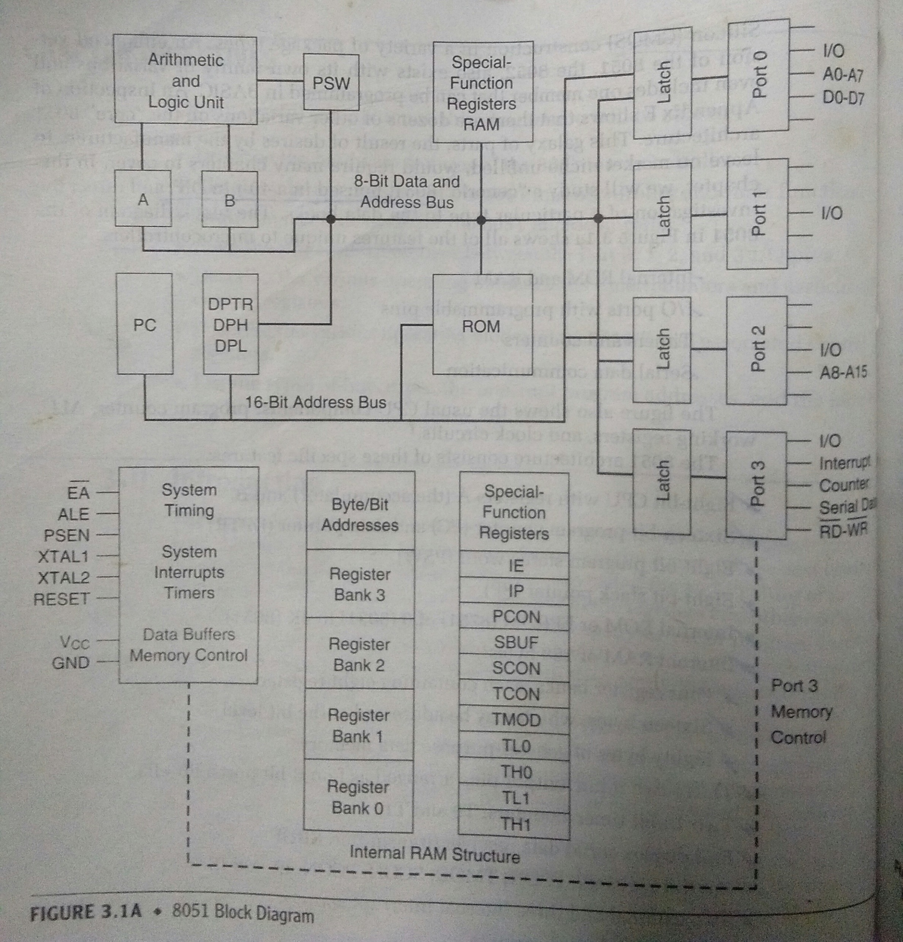

Slide 5
8051 Architecture consists of these specific features:
Eight bit CPU with Registers A (the Accumulator) and B
Sixteen-bit program counter (PC) and Data Pointer (DPTR)
Eight bit Program Status Word (PSW)
Eight bit Stack Pointer (SP)
Internal ROM or EPROM (8751) of (8031) to 4K (8051)

Slide 6
Cont..
Internal RAM of 128 bytes :
Four register banks, each containing eight registers.
Sixteen bytes, which may be addressed at the bit level.
Eighty bytes of General-purpose data memory
32 I/O pins arranged as four 8-bit ports : P0-P3.
Two 16 bit Timer/Counters : T0 and T1.
Full duplex serial data receiver/transmitter : SBUF.

Slide 7
Contd..
Control registers : TCON , TMOD, SCON, PCON, IP and IE
Two external and three Internal Interrupt Sources.
Oscillator and Clock Circuits.

Slide 8
Eight bit CPU registers A and B
The 8051 contains 34 general purpose or working registers.
Two of these are A and B.
A : The immediate result is stored in the Accumulator Register (Acc) for next Operation.
B: This register is for Multiplication and Division Operation.

Slide 9
Program Status Word(PSW)
The PSW contains 4 math flags, User program flag F0 and the register select bits that identify which of the four General-purpose register banks is currently in use by the program.
The math flags include carry(c),auxiliary carry(AC),overflow(OV) and parity(p).

Slide 10
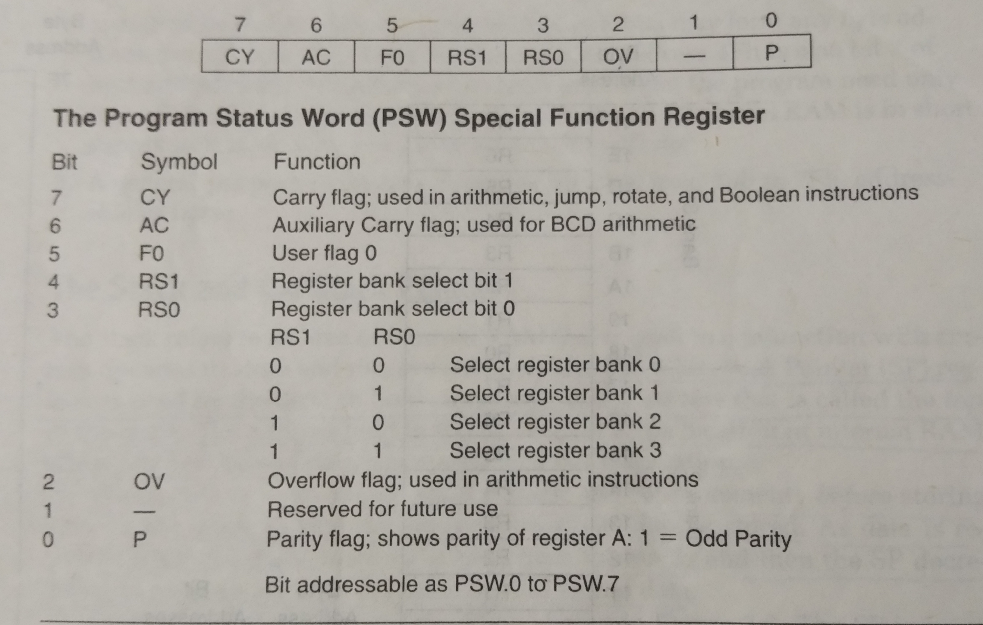

Slide 11
With RS1 and RS0 bits we can select the corresponding register bank.
RS1 | RS0 | Register Bank | Address
0 | 0 | 0 | 00H-07H
0 | 1 | 1 | 08H-0Fh
1 | 0 | 2 | 10H-17H
1 | 1 | 3 | 18H-1FH

Slide 12
Data Pointer(DPTR)
The data pointer is 16 bit register.
It is used to hold the address of the data in the memory.
The DPTR register can be accessed separately as lower eight bit(DPL) and higher eight bit (DPH).
It can be used as a 16 bit data register or two independent data register.

Slide 13
Program Counter(PC)
The PC points to address of next instruction to be executed.
As the CPU fetches opcode from the program ROM, the program counter is increasing to point to the next instruction.
The PC is 16bit wide.
This means that it can access program addresses 0000H to FFFFH, a total of 64K bytes of code.

Slide 14
Stack Pointer(SP)
The stack is a section of RAM used by the CPU to store information temporarily
This information could be data or an address.
The register used to access the stack is called the SP(stack pointer) register.
The stack pointer in the 8051 is only 8 bit wide.

Slide 15
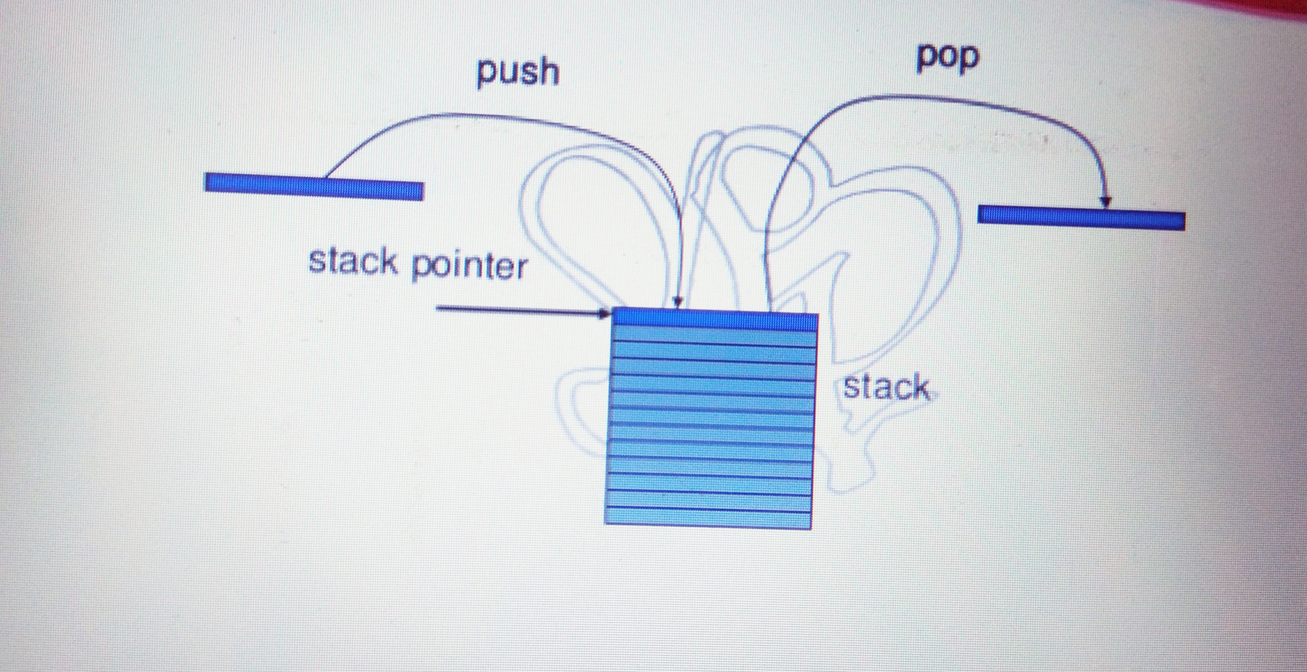
Operation On Stack

Slide 16
Internal Memory
128 bytes of RAM.
Directly addressable range: 00 to 7F hexadecimal.
Indirectly addressable range: 00 to FF hexadecimal.
Bit addressable space: 20 to 2F hexadecimal .
Four register banks: 00 to 1F hexadecimal.

Slide 17
Internal RAM
The 128 byte internal RAM shown in figure.
It is organized into three areas.
1.Working register:
Thirty-two bytes from address 00h to 1Fh that make up 32 working register organized as Four bank of eight bit each.
Bits RS0 and RS1 in the PSW determine which bank of register is currently Is use.
Bank 0 is selected upon reset.

Slide 18
Cont..
2.Bit addressable:
A bit addressable area of 16 bytes occupies RAM bytes addresses 20h to 2Fh,forming A total of 128 addressable bits.
An addressable bit may be specified by its bit address of 00h to 7Fh.
3.General purpose:
A general-purpose RAM area above the bit area, form 30h to 7Fh,addresable as bytes.

Slide 19
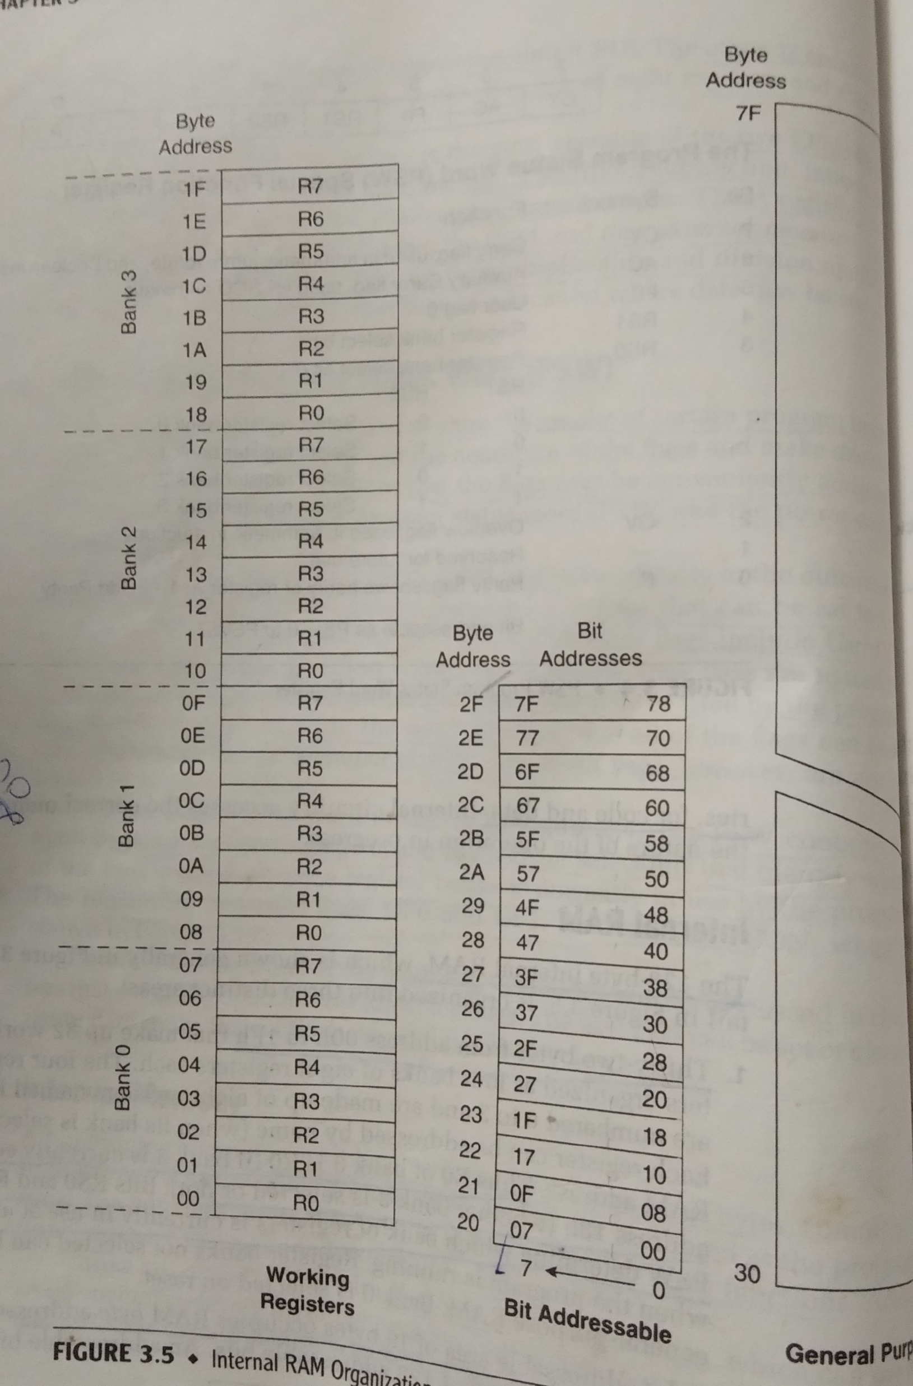
Internal RAM Organisation

Slide 20
External Memory
External memory is used in cases when the internal ROM and RAM memory Available On chip is not sufficient.
Two separate are made available by the16-bit PC and the DPTR and by different control pins for enabling external ROM and RAM chips.
If the 128 bytes of internal RAM is insufficient, the external RAM is accessed by the DPTR.
In the 8051 family, external RAM of upto 64 KB can be added to any chip.

Slide 21
Special Function Register
The 8051 operations that do not use the internal 128Byte RAM addresses from 00H to 7FH are done by a group of specific internal registers, each called a Special Function Register(SFR).
The SFR registers have addresses between 80H and FFH. Not all the address space of 80 to FF is used by SFR.
The unused locations 80H to FFH are reserved and must not be used by the 8051 programmer.
There are 21 SFRs.

Slide 22
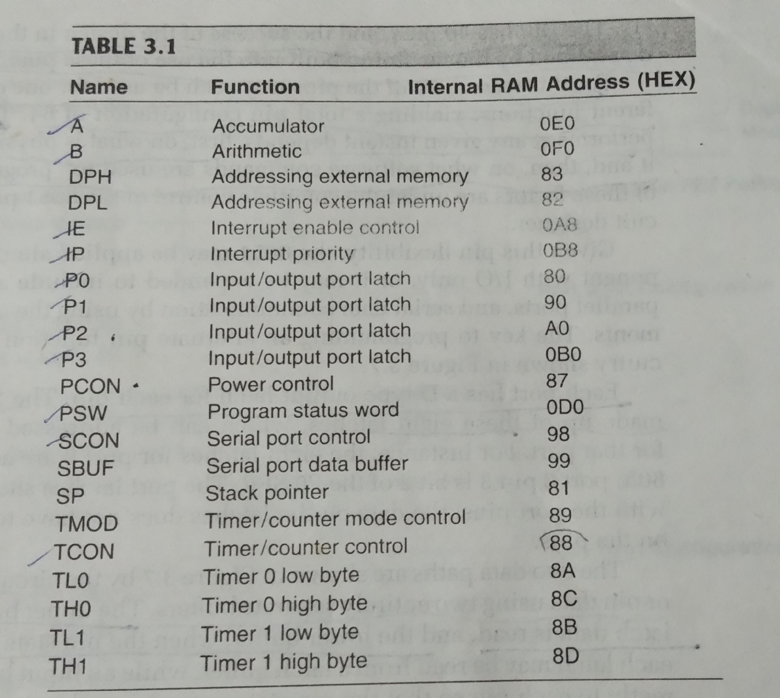

Slide 23
Special Function Register(SFR) cont..
128 byte address space, directly addressable as 80 to FF hex.
16 addresses are bit addressable: (those ending in 0 or 8).
This space contains:
Special purpose CPU registers.
I/O ports.
Interrupt control
Timers
serial I/O

Slide 24
Special Function Register (SFR) cont..
CPU registers :
ACC : Accumulator
B : B register.
PSW : Program Status Word.
SP : Stack Pointer.
DPTR : Data Pointer (DPH, DPL).

Slide 25
Special Function Register (SFR) cont..
Interrupt control:
IE : Interrupt Enable.
IP : Interrupt Priority
I/O Ports :
P0 : Port 0.
P1 : Port 1.
P2 : Port 2.
P3 : Port 3.

Slide 26
Special Function Register (SFR) cont..
Timers :
TMOD : Timer mode.
TCON : Timer control.
TH0 : Timer 0 high byte.
TL0 : Timer 0 low byte.
TH1 : Timer 1 high byte.
TL1 : Timer 1 low byte.
Serial I/O :
SCON : Serial port control.
SBUF : Serial data registers.
Other :
PCON : Power control

Slide 27
I/O Ports
Four 8-bit I/O ports.
Port 0
Port 1
Port 2
Port 3

Slide 28
Port 0
Port 0 is a dual purpose port, it is located from pin 32 to pin 39 (8 pins).
To use this port as both input/output ports each pin must be connected externally to pull-up resistor.
Alternate functions:
As a multiplexed data bus.
8-bit instruction bus, strobed by PSEN
Low byte of address bus, strobed by ALE
8-bit data bus, strobed by WR and RD.

Slide 29
Port 1
Port 1 is a dedicated I/O port from pin 1 to pin 8
Upon reset it is configured as outport.
It is generally used for interfacing to external device
Thus if you need to connect to switches or LEDs, you could make use of these 8 pins, but it doesn’t need any pull- up resistors as it is having internally

Slide 30
Port 2
Like port 0, port 2 is a dual-purpose port.(Pins 21 through 28)
It can be used for general I/O or as the high byte of the address bus for designs with external code memory.
Like P1 ,Port2 also doesn’t require any pull-up resistors
Alternate functions: High byte of address bus for external program and data memory accesses

Slide 31
Port 3
Port 3 is also dual purpose but designers generally avoid using this port unnecessarily for I/O because the pins have alternate functions which are related to special features of the 8051.
Indiscriminate use of these pins may interfere with the normal operation of the 8051.
As an I/O port: Standard quasi-bidirectional.
Alternate functions:
Serial I/O - TXD, RXD
Timer clocks - T0, T1
Interrupts - INT0, INT1
Data memory- RD, WR

